Slide 1
A Light SRGAN for Low Resolution and High Latency Images
Archan Ghosh, Kalporoop Goswami, Riju Chatterjee, Paramita Sarkar

Slide 2
Problem Statement
Since the inception of images, the process of enlarging images has not been hassle free:
Traditional Methods like interpolation didn’t produce much promising results.
Edge correction is a major problem.
Cannot work on variety of resolution.
Newer Methods:
Tend to be very heavy.
is not easy to use from the get go.
Though there are Many Neural Network Approaches:
They overlook the very small pixel range where details are absent
Mechanism are sometimes not clearly defined.
Can lack certain features depending on what they are trained with.
We propose a method where a heavy duty NN system like SRGAN can be used for Low Resolution Images, without causing much hindrance in-terms of resource allocation
Archan Ghosh, Student R.H

Slide 3



Proposed Method
SRGAN Was Created in 2017 to Tackle the fundamental problem of Super Resolution.
Principle
2 | 4 | 4 | 12
6 | 1 | 3 | 9
3 | 5 | 6 | 4
8 | 4 | 6 | 5
1 | 3
5 | 6
“Catch the Clarity”
<-General
<- Proposed
Archan Ghosh, Student R.H

Slide 4
Objectives:
 | Ours | SoTA(Ledig 2017)
Epochs | 5000 (Baseline) 35000 (Optimized) | ≈ 10⁶
Sample Size | 8000 | 350K
Training TIme | 6-8 Hours | ≈18-37 Hours
Short
Simple
Light
Information flow and control of Parameters can be easily understood in the networks
The overall model’s size after training and evaluation was made to be less than 35 MB is size (in most test cases it was less than 20 MB) without the need of compression
Archan Ghosh, Student R.H

Slide 5
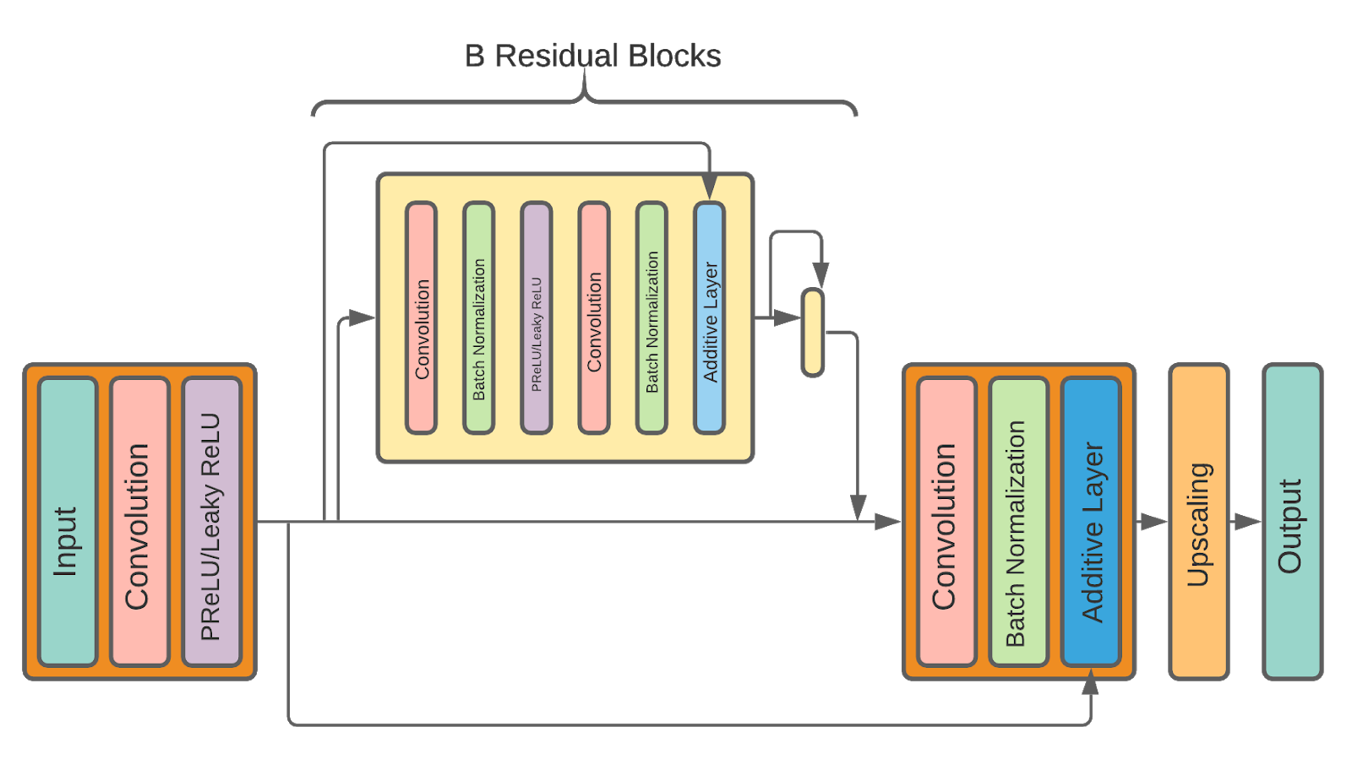
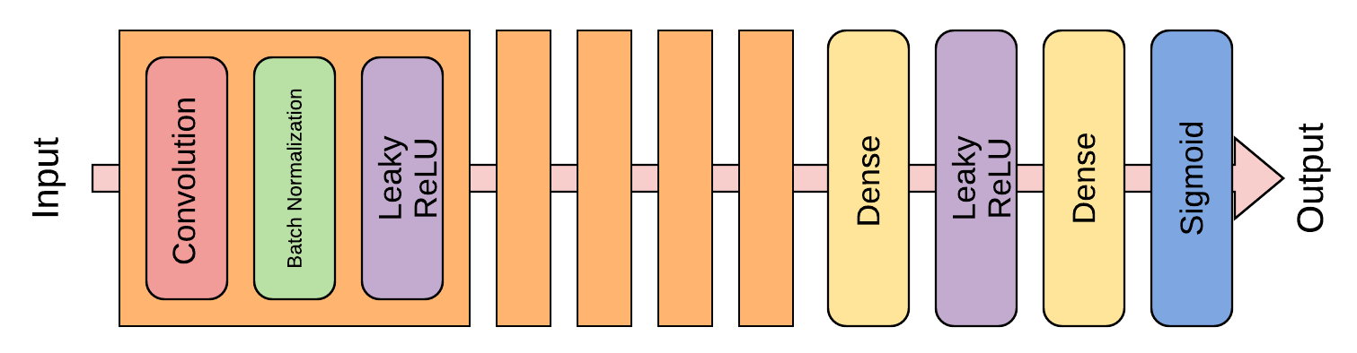
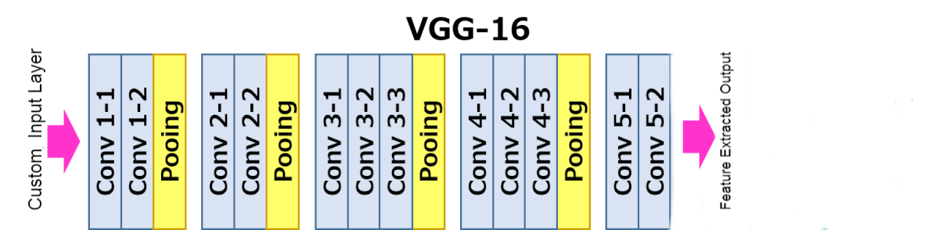
Architecture
Generator:
Discriminator:
VGG with Custom Input Layer and Early Extraction:
Archan Ghosh, Student R.H

Slide 6
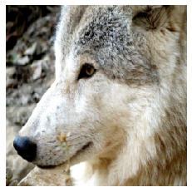

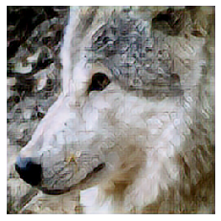
Methodology/Pipeline
Original
Generated
Generator
Compression
LR
VGG-19
Feature Extraction
Relative Similarity
Discriminator
Archan Ghosh, Student R.H

Slide 7
Average Loss Over | Div2k Dataset | Coil-100 Dataset
Generator | 0.343 | 0.382
Discriminator | 0.372 | 0.374
 | PSNR | SSIM
32px to 128px over COIL-100(5000 Epochs) | 17.0 | 0.252
32px to 128px over Div2k(35000 Epochs) | 20.2 | 0.589
64px to 256 px over Div2k(35000 Epochs) | 22.6 | 0.699
Archan Ghosh, Student R.H

Slide 8

Archan Ghosh, Student R.H

Slide 9
Future Work
In terms of Model Performance:
Expanding the Model to a multi-resolution support without retraining it.
Increasing the overall Structural Index of the outcomes by providing clipped inputs.
In terms of accessibility:
Serving the model, where we can easily access it to convert images
Make the internal layers of the model accessible so it can be extracted.
Archan Ghosh, Student R.H

Slide 10
Thank You
Archan Ghosh, Student R.H

